Slide 1
Words & Music Rev. Nick ‘The Vic’ Wood
Copyright © 2014 Rev. Nick ‘The Vic’ Wood

Slide 2
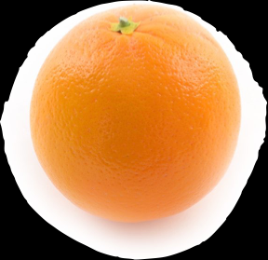
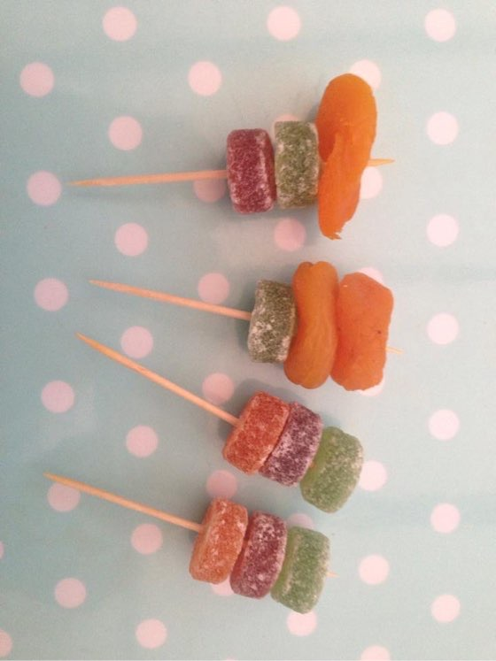
First you take an orange
because the
world is round;
with four seasons
and all the yummy stuff
that grows
in the ground.

Slide 3
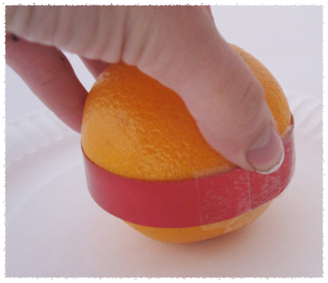
A red ribbon -
round the middle -
because Jesus gave his life
for all God’s people;

Slide 4
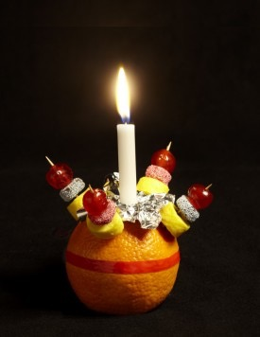
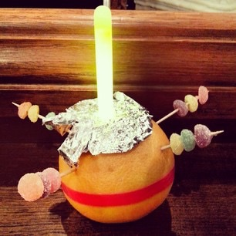
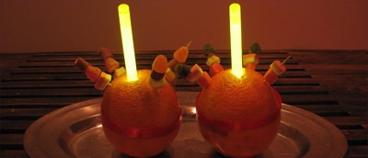
And a light on top
because his love
will never stop.

Slide 5
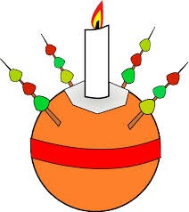
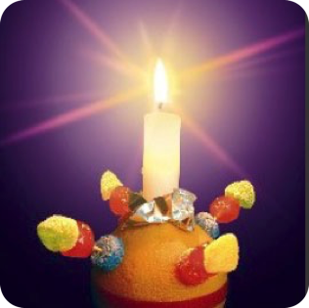
Now you’ve got
your christingle;
shining clear and bright.
We can be
like christingles
and shine hope
into the night.

Slide 6
First you take an orange
because the
world is round;
with four seasons
and all the yummy stuff
that grows
in the ground.

Slide 7
A red ribbon -
round the middle -
because Jesus gave his life
for all God’s people;

Slide 8
And a light on top
because his love
will never stop.

Slide 9
Now you’ve got
your christingle;
shining clear and bright.
We can be
like christingles
and shine hope
into the night.

Slide 10
Instrumental Break

Slide 11
First you take an orange
because the
world is round;
with four seasons
and all the yummy stuff
that grows
in the ground.

Slide 12
A red ribbon -
round the middle -
because Jesus gave his life
for all God’s people;

Slide 13
And a light on top
because his love
will never stop.

Slide 14
Now you’ve got
your christingle;
shining clear and bright.
We can be
like christingles
and shine hope
into the night.

Slide 15
First you take an orange
because the
world is round;
with four seasons
and all the yummy stuff
that grows
in the ground.

Slide 16
A red ribbon -
round the middle -
because Jesus gave his life
for all God’s people;

Slide 17
And a light on top
because his love
will never stop.
And a light on top
because his love
will never stop.

Slide 18
DOWNLOAD
The Christingle Song
Vocal version and backing track
COMPLETELY FREE
at
www.nickthevic.co.uk

